Slide 1

MOTORBOAT TRAINING, TESTING & LICENSING
Presenter:
Title: Fire Suppression
Manual – TAB 6
Date:

Slide 2
FIRE SUPPRESSION
Objectives:
Understand the 4 fire classes and their fuel sources
Learn the procedures if a fire erupts on your boat
Understand the legal requirements for fire extinguishers
Learn the USCG and COE fire extinguisher requirements
for Class A and Class I boats
Learn what P.A.S.S. stands for
Learn the procedures for fueling your boat

Slide 3
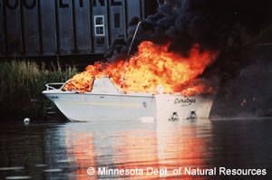
How would you explain this on an ENG 3394?

Slide 4
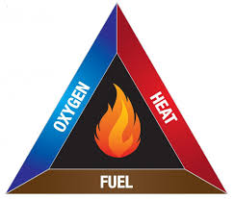
What is required for a fire to burn?

Slide 5




Fire Class & Fire Extinguisher Type
Fuel Source | Class of Fire | Type of Extinguishing Agent
Ordinary combustibles (e.g. trash, wood, paper, cloth) | A | Water; chemical foam; dry chemical*
Flammable liquids (e.g. oils, grease, tar, gasoline, paints, thinners) | B | Carbon dioxide (CO2); halon**; dry chemical; aqueous film forming foam (AFFF)
Electricity (e.g. live electrical equipment) | C | CO2; halon; dry chemical
Combustible metals (e.g. magnesium, titanium) | D | Dry powder (suitable for the specific combustible metal involved)

Slide 6
Fire Extinguisher Requirements
Marine Type USCG Approved
Type & Size Symbols, USCG approval no.
Extinguishers should be immediately accessible
Mounted Correctly
Maintained in a serviceable condition
  Inspect Regularly
  Seal is not broken or missing
  Gauges are in operable range

Slide 7
TYPE & QUANTITY of Fire Extinguishers
Length of Vessel | Without Fixed System ** | With Fixed System *
Less than 26 feet | one B-I | None
26 feet to less than 40 feet | two B-I or one B-II | one B-I
40 feet to less than 65 feet | three B-I or one B-II and one B-I | two B-I or one B-II
*refers to a permanently installed system **USCG requirement
EM 385-1-1, 19.F.03 a. - Corps vessels under 26 feet require one 1A:10BC

Slide 8
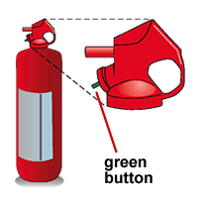
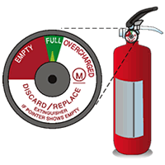
Fire Extinguisher Charge Indicators
To check this style of extinguisher, depress the green button. If it is fully charged, the green button should pop back out immediately.
On this style of fire extinguisher, the needle indicator should be in the "full" range.

Slide 9
What Does P . A . S . S . Stand For ?

Slide 10
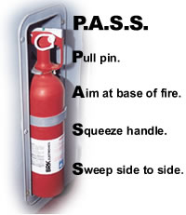

Slide 11
Fueling Your Vessel: Before Fueling
Secure vessel to the fueling dock
All Passengers will Exit the Boat
No smoking is permitted during fueling
Ensure Fuel Lines, Connections, & Fuel Vents are OK
Turn off anything that may cause a spark – engine, fans
Turn off fuel valves and extinguish all open flames
Close all windows, ports, doors, and openings to prevent fumes from entering vessel
Remove portable fuel tanks to fill
Ensure fire extinguisher is in reach

Slide 12
Fueling Your Vessel:
While Fueling
Keep the nozzle of the fuel-pump hose in solid contact with the tank opening to prevent producing a static spark
Use caution and fill the tank slowly to avoid spilling fuel into the boat’s bilge or into the water. Use an oil-absorbent pad to catch drips or spills.
Never fill a tank to the brim – leave room for fuel to expand

Slide 13
Fueling Your Vessel:
After Fueling
Put the fill cap on tightly to prevent vapors from escaping
Wipe up any spilled fuel and properly dispose of the used paper towels on shore
Open all windows, ports, doors, and other openings
If your boat is equipped with a power ventilation system (exhaust blower), turn it on for at least four minutes before starting your engine. This will eliminate fuel vapors in the bilge.
Before starting the engine, sniff the bilge and engine compartments for fuel vapors. Continue ventilating until you cannot smell any fuel vapors.
Start the engine and reload your passengers.

Slide 14
If Fire Erupts on YOUR Boat
If Underway, stop the boat
Have everyone who is not wearing a PFD put one on
Position the boat so that the fire is DOWNWIND
If the fire is in an engine space, shut off the fuel supply
Aim the fire extinguisher at the base of the flames, P.A.S.S.
Never use water on a gasoline, oil, grease, or electrical fire
Summon help with your VHF marine radio
Abandon ship if necessary

Slide 15
REVIEW:
What are the 4 classes of fires and their respective
fuel sources?
What does P.A.S.S. stand for?
What are the three things that make up the ‘Fire Triangle’?
What are the steps to take if a fire breaks out on the boat?
What is the USCG requirement for Class A & Class I boats?
What is the COE requirement for Class A & Class I boats?
Name three things to do before fueling.
Name three things to do while fueling.
Name three things to do after fueling.
T/F – A bungee makes a great fire extinguisher bracket.
What is the USACE Fire Extinguisher Requirement for boats
under 26’ in length?

